Slide 1
Apple Employee Performance Analysis Dashboard
SQL, Power Bi Project

Slide 2
Data set
Employee, Performance, Training, Feedback tables in .csv format.
Employee ID is found as unique id to all employees.
Employee ID is found in all four tables and it is set as primary key.
No null value found.

Slide 3
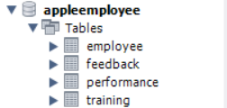
SQL
Database creation
SQL DATABASE
In Sql New Database created
Four tables imported.
Primary key, Foreign key- Employee ID, Metric ID, Training ID, Feedback ID added
Faced an error during this. Name of the primary key (employee id) column did not match in all tables. Changes were done.

Slide 4
SQL QUERY
Query 1 - Top 10 Performing employees by project completion rate.
Query 2 - Department wise average project completion rate.
Query 3 – Training effectiveness.
Query 4 – Feedback analysis. Positive -25, Neutral – 13, Negative- 12.
Query 5 – Department wise Average Employee satisfaction score

Slide 5
SQL – POWER BI SERVER CONNECT
In Power Bi MySql server connected.
Tables from SQL was loaded.
KPI cards – Employee performance score, Project completion rate, Tasks completed.
Filter created to search with employee id.
4 department selection created.

Slide 6
POWER BI -DAX
New column and quick measures created to fine employee tenure in the company.
DAX used :
YearsOfExperience = DATEDIFF('appleemployee employee'[HireDate], TODAY(), YEAR)

Slide 7
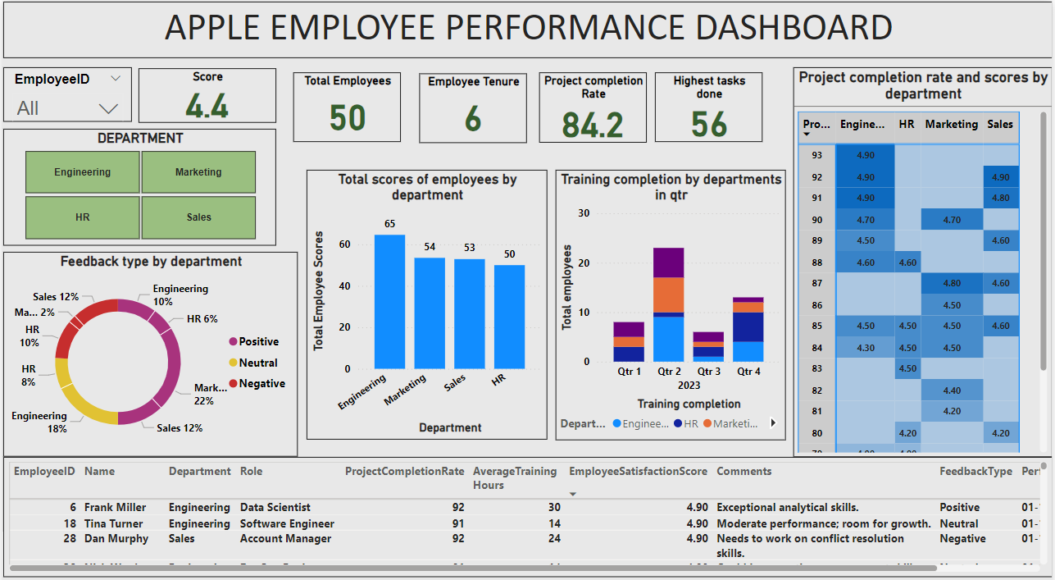

Slide 8
Insights
Comparing to four quarters in 2023 in 2nd quarter more employees were trained.
Higher the Project completion rate, higher the employee score.
Leading performance – Engineering department.
Total employees - 50
Average Employee score – 4.4
Average Tenure period of employee – 6
Average project completion rate – 84.2
Highest tasks completed per employee – 56 Tasks.

Slide 9
Thank you
-Revathi D
revathidu@gmail.com

